Slide 1
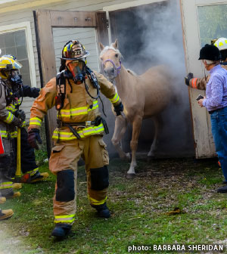


Fire Prevention – Horse Farms

Slide 2
Goals for Today
Fire Safety – lines of defence
Fire behaviour basics
Fire Prevention
Assisting First Responders
Resources and Education
Ultimate goal –
You are the first line of Defence

Slide 3
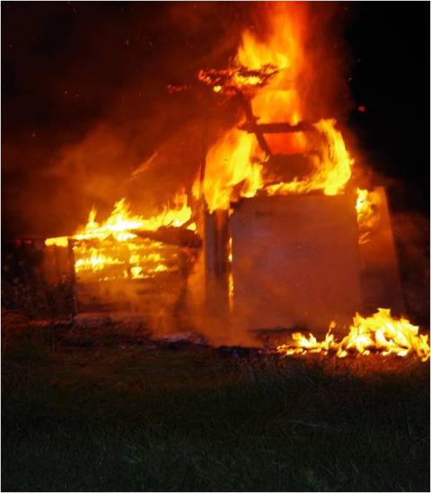
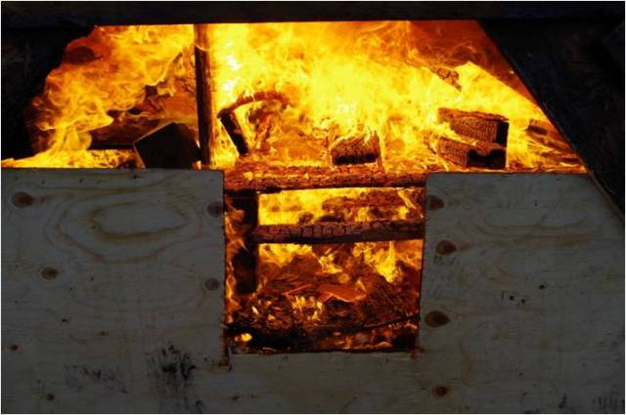
Barn fires:
You are the first line of defence
Slide courtesy of Robert Nagle – Severn Fire Department

Slide 4
Fire safety -
3 lines of defence:
Education/prevention
Inspection/enforcement
Fire suppression
Slide courtesy of Robert Nagle – Central York Fire Services
Notes:
4

Slide 5
Education/Prevention:
Proactive
Directly involves the farm owner
Most effective way to deal with fires
Slide courtesy of Robert Nagle – Central York Fire Services

Slide 6
Inspection/enforcement:
Combination of proactive & reactive
Many agricultural buildings are exempt from Fire Code
Slide courtesy of Robert Nagle – Central York Fire Services

Slide 7
Fire suppression:
100% reactive
Least effective way to deal with fires
Slide courtesy of Robert Nagle – Central York Fire Services

Slide 8
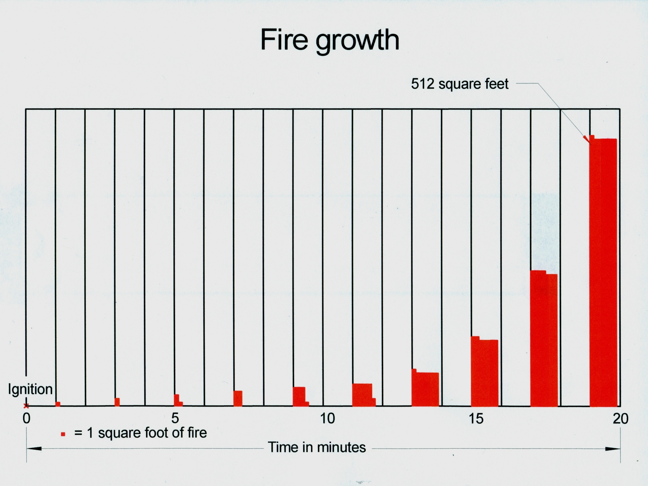
Slide courtesy of Robert Nagle – Central York Fire Services

Slide 9
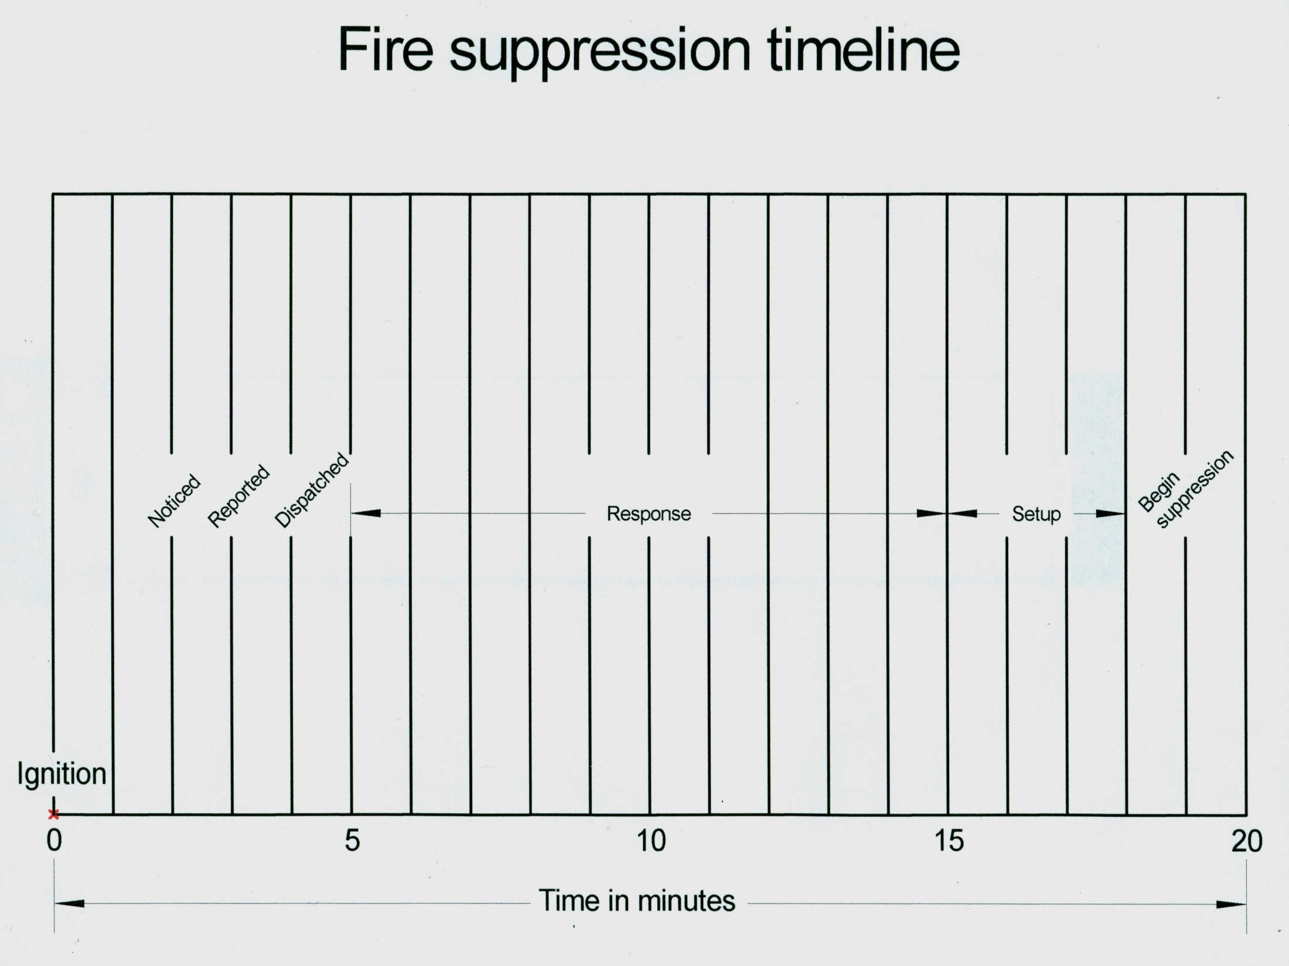
Slide courtesy of Robert Nagle – Central York Fire Services

Slide 10
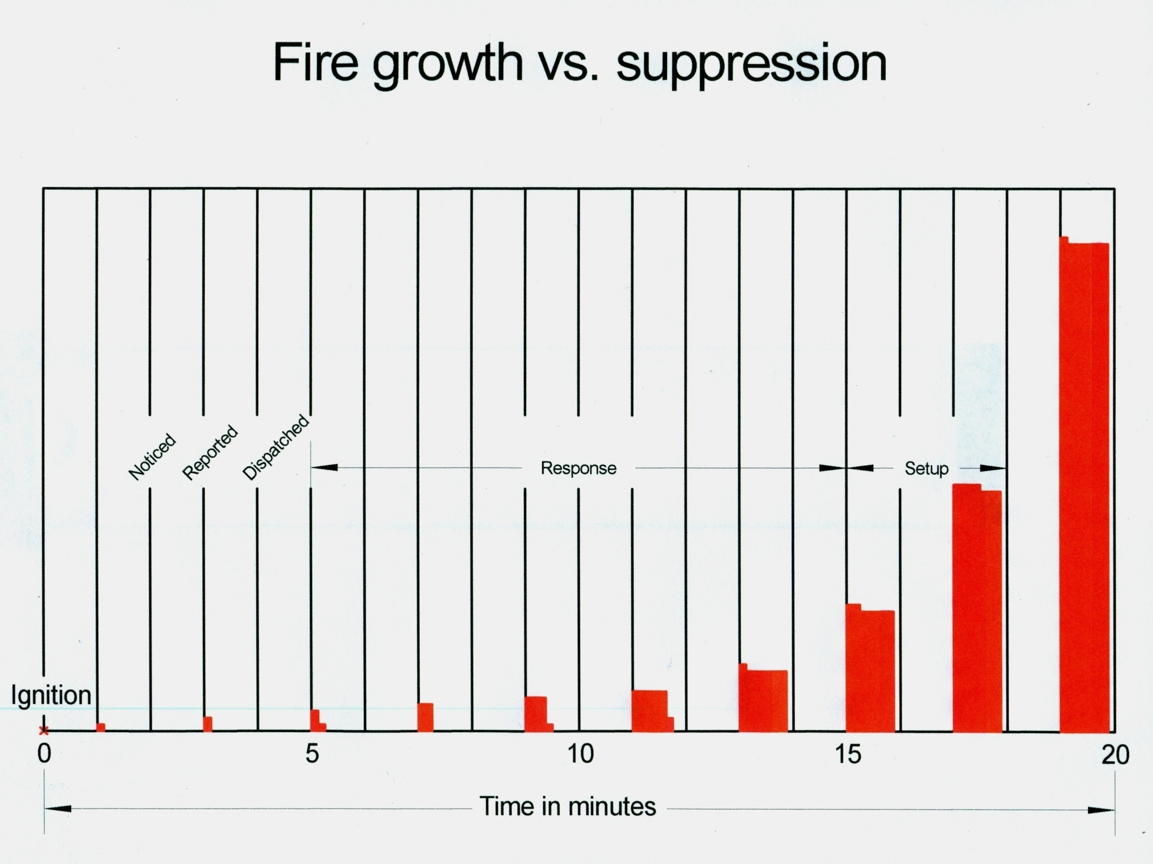
Slide courtesy of Robert Nagle – Central York Fire Services

Slide 11
During a barn fire – time is against you
Building material and Construction
Feed and bedding is highly combustible
Burns with heat similar to gasoline
Injury occurs rapidly
4f diameter fire – injury
6f diameter fire – Acute Lung Injury
8f diameter fire – Suffocation
10f diameter fire - Death
Wood frames
Large structures – no compartmentalization
Electrical safety
Zajaczkowski and Wheeler – Penn State G 100
Notes:
www.strangefarmer.com

Slide 12
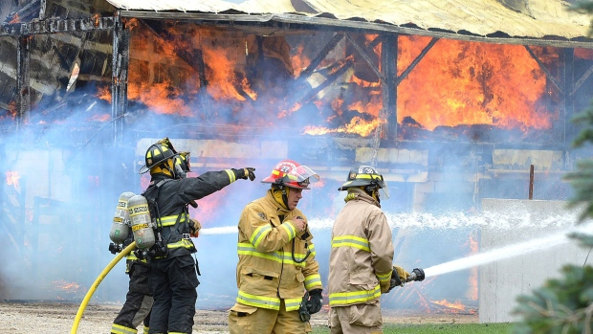
Fire Prevention
Starts with you!

Slide 13
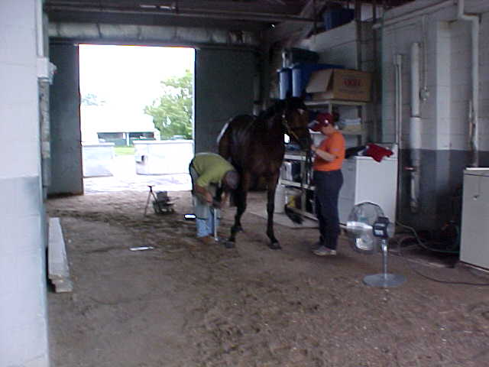
Fire Prevention
Horse Related Trades People In your Barns?
BLACK SMITH TOOLS?
GRINDERS?
NO SMOKING?
PROPANE TORCHES?
FANS?
Slide courtesy of Bob Webb, Former,CFPO, & WEG FM,RET.

Slide 14
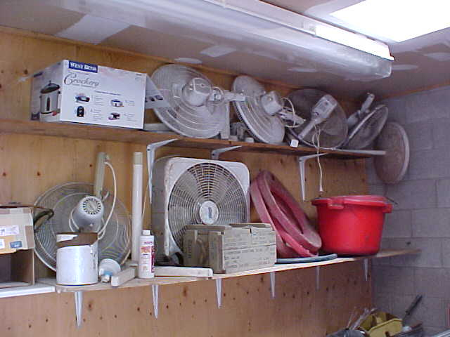
Fire Prevention
UNAPPROVED FANS, Not TO BE USED IN BARNS
CHANCE OF FIRE WHERE THERE IS OPEN ACCESS TO THE HOT MOTOR
CHANCE OF FAN FALLING OVER
Slide courtesy of Bob Webb, Former,CFPO, & WEG FM,RET.

Slide 15
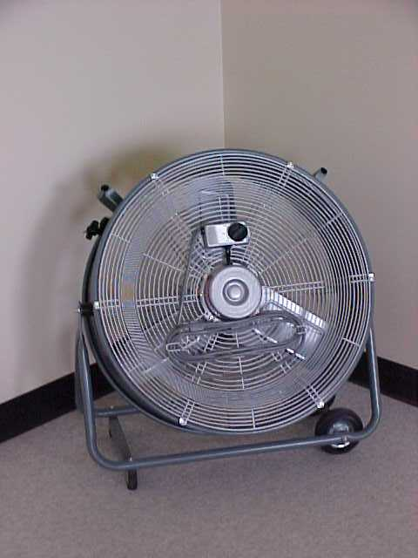


Fire Prevention
BARN FANS
CSA APPROVED FOR HAZARDOUS ATMOSPHERES
Slide courtesy of Bob Webb, Former,CFPO, & WEG FM,RET.

Slide 16
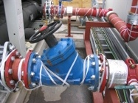
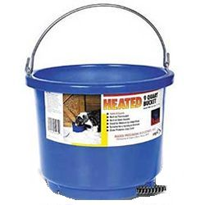
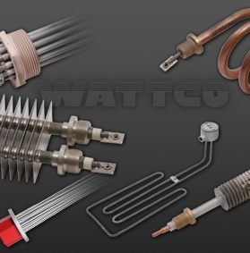
Fire Prevention
HEAT TRACING FOR WINTER WATER SUPPLY
  EQUIPMENT MUST BE CSA APPROVED
  INSTALLED BY QUALIFIED ELECTRICIAN
  ENSURE EQUIPMENT HAS A SHUT OFF SWITCH
  Portable heaters /pail heater should be plugged into a GFCI
Slide courtesy of Bob Webb, Former,CFPO, & WEG FM,RET.

Slide 17
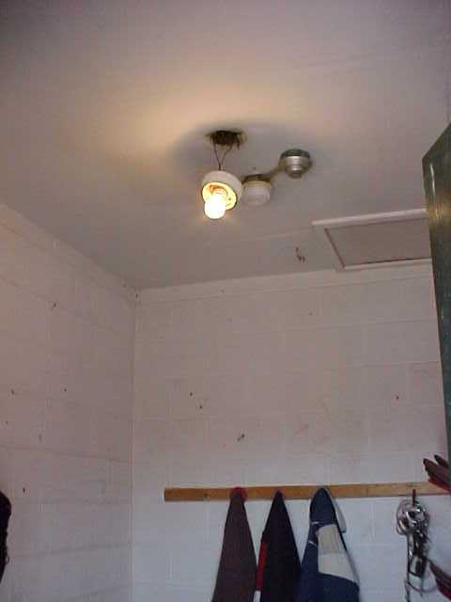
Fire Prevention
ELECTRICAL LIGHTS NOT PROPERLY FASTENED
BULBS SHOULD BE ENCLOSED WITH A GLASS SHIELD OR METAL HOUSING
EXTENTION CORDS NOT TO BE USED AS PERMANENT WIRING
HOW IS THE WIRING IN YOUR BARN?
HAVE A QUALIFIED LICENCED ELECTRICIAN CHECK IT OUT
Slide courtesy of Bob Webb, Former,CFPO, & WEG FM,RET.

Slide 18
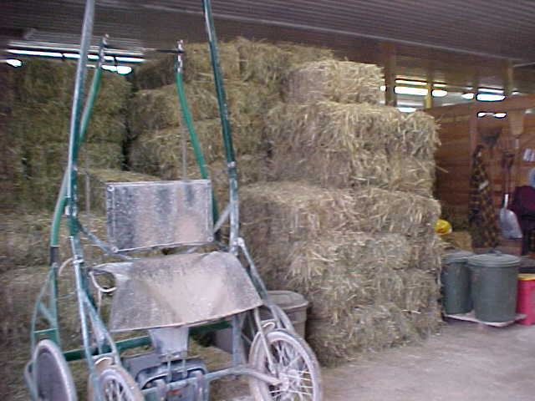
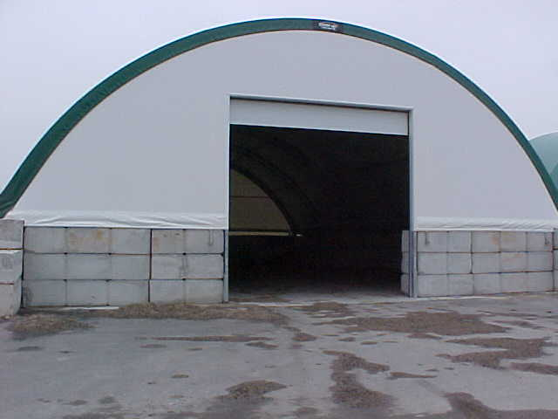
Fire Prevention
Question:
How much straw, hay & shavings can be stored safely?
Only a daily amount in shed row of straw/hay
Storage of extra should be in a fire separated area or in a separate building
Slide courtesy of Bob Webb, Former,CFPO, & WEG FM,RET.

Slide 19
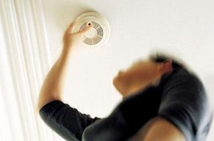

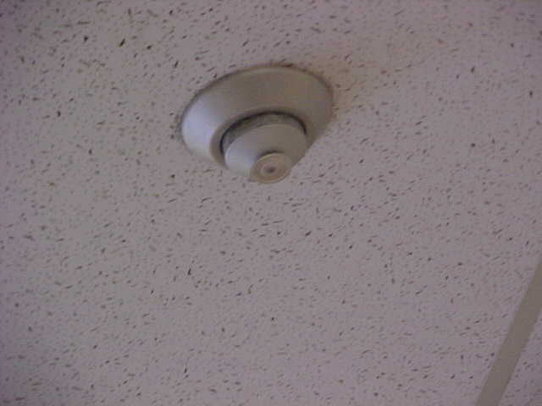
Fire Prevention
DETECTION & Protection
    Sprinklers-135 F
    Heat Detector-135 F
    Smoke Detector – less than 2 minutes
Slide courtesy of Bob Webb, Former,CFPO, & WEG FM,RET.

Slide 20
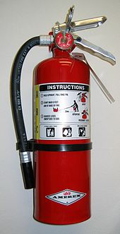
Fire Prevention
Portable Fire Extinguishers
INSTALL A 20 LB. ABC MULTIPURPOSE FIRE EXTINGUISHER INSIDE AT EVERY BARN EXIT DOOR.
ENSURE THESE ARE CHECKED WEEKLY TO ENSURE THEY ARE NOT DAMAGED, DIRTY / COBWEBS OR DISCHARGED.
Slide courtesy of Bob Webb, Former,CFPO, & WEG FM,RET.

Slide 21
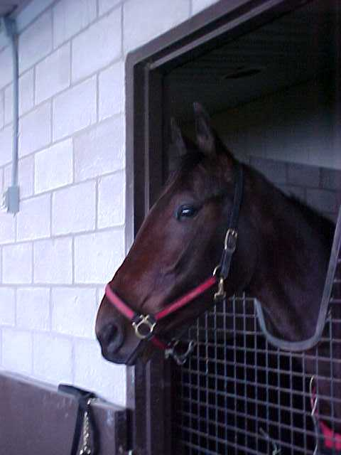
Fire Prevention
Must Horses Wear Halters in the stall overnight?
Frightened horses?
(without) How to evacuate?
(with) Safer removal
Means of Horse identification
Slide courtesy of Bob Webb, Former,CFPO, & WEG FM,RET.

Slide 22
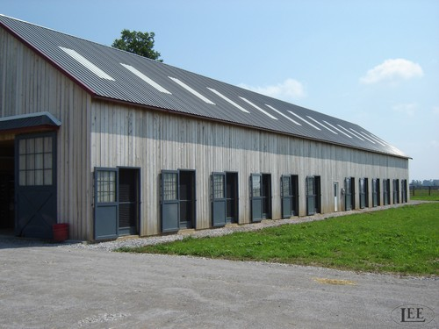
Fire Prevention
Building construction:

Slide 23
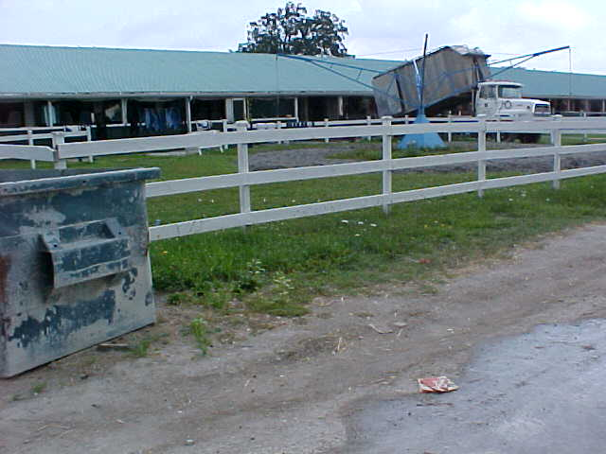
Fire Prevention
SAFE EVACUATION AREAS
REMOVE HORSES TO A PADDOCK OR FENCED AREA FOR SAFETY AWAY FROM THE FIRE
IF PADDOCK NOT AVAILABLE LET THEM LOOSE IN A PASTURE AREA
Slide courtesy of Bob Webb, Former,CFPO, & WEG FM,RET.

Slide 24
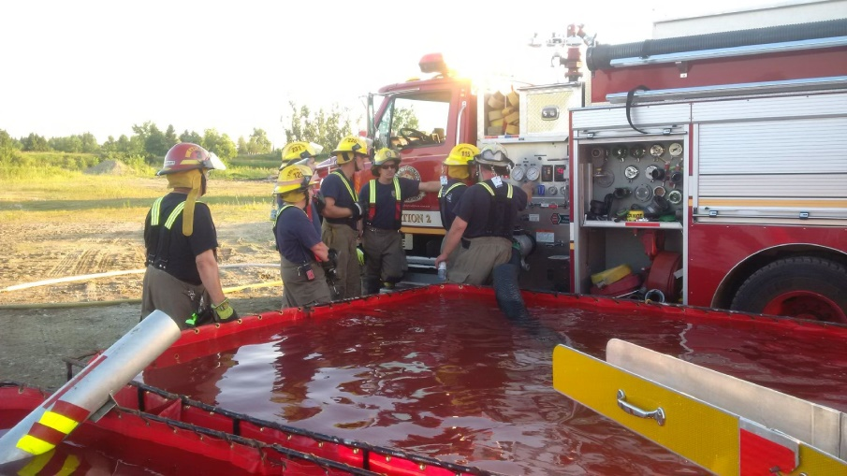
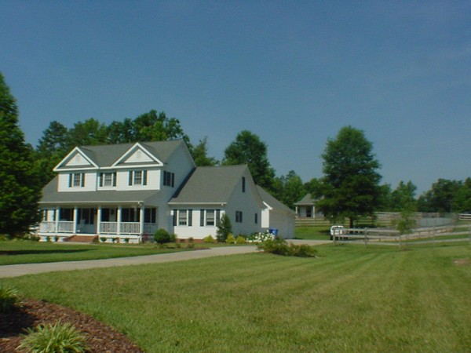
How to best assist your fire department
Introduce yourself to FD before an issue and create a pre-plan
Know Your Farm Address – Ensure it is visible
Be sure you know the Fire Department Phone Number
Have someone Meet Fire Department at the road

Slide 25

Evaluate Your Property
Clear access.
Determine driveway conditions:
  width;
  grading;
  clearance height (low lying branches);
  snow or other barriers;

Slide 26
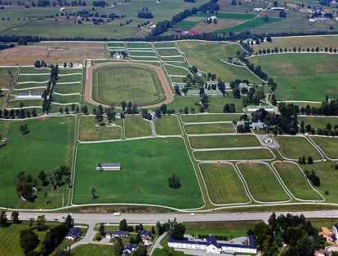
Evaluate Your Property
Multiple Buildings/Locations
Give location to 911 operator
Staff at entrance to direct responders
  Be prepared for multiple responding units

Slide 27
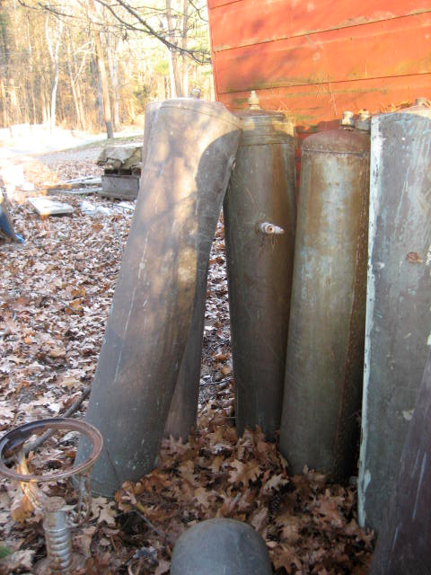
Identify potential hazards surrounding the structure
Keep combustible objections and vehicles away from the foundation, i.e., tractor, truck, trailers…etc.
Fuel tanks should be safely stored elsewhere
Evaluate doorways - Do not nail doors shut from the inside

Slide 28
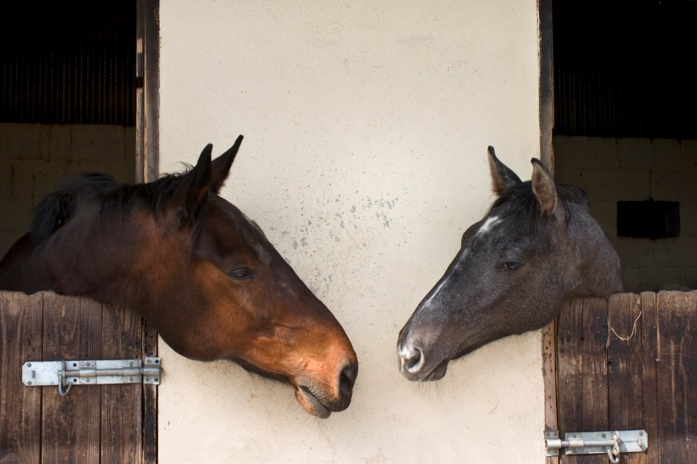
Take Inventory of the situation
Is someone in the structure?
Was the fire evacuation plan executed? and Is everyone accounted for?
Understand the barn design
  multiple storeys, loaf, drive sheds, and entry points.
Inventory of the barn content:
  Livestock, chemical, fertilizers, fuels, accelerants and other hazards.
Have one spokes person relay all the information to IC (Incident Command).

Slide 29
How to be part of the solution?
Don’t be a Hero, stay back within the established safety perimeter.
Respect IC leadership, and judgement.
If, IC has setup collapse zones for falling debris, adhere to the restricted area for your safety.
Let us let do our job!
We work as a team for your safety!

Slide 30
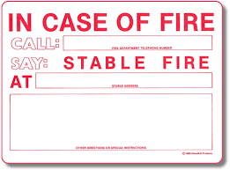
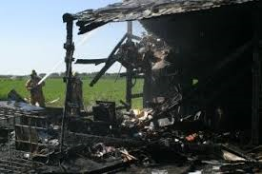
Common Sense is Not so Common!!!
Get out ! Stay out!
Know your emergency phone numbers and emergency contacts
Do Not Hesitate to CALL 911.

Slide 31
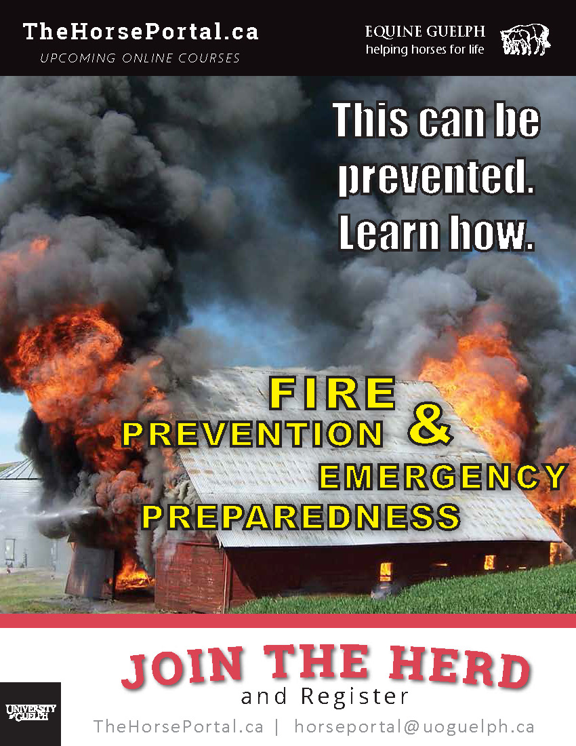
Equine Guelph Program

Slide 32
Barn Fire Safety Top 10
Checklist of top 10 safety concerns both inside and outside
www.EquineGuelph.ca
for additional resources

Slide 33
Fire Prevention
Thank You!
Questions?

